Slide 1
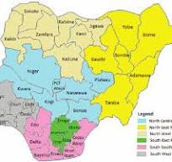
2019 Nigerian Presidential Election Analysis
Key Insights & Voting Patterns
By Udochi Ogbonna

Slide 2
Introduction
Objective: To provide insights into the 2019 Nigerian Presidential Election.
Overview: Summary of key metrics including total votes, turnout, and geopolitical voting patterns.
Purpose: To enhance understanding and foster informed discussions among stakeholders.

Slide 3
Election Summary
• Key Parties & Results:
APC (All Progressive Congress): 15 million votes (Winner)
PDP (People's Democratic Party): 11 million votes
Other Parties: 870,000 votes
• Total Votes Cast: 29 million (valid)

Slide 4
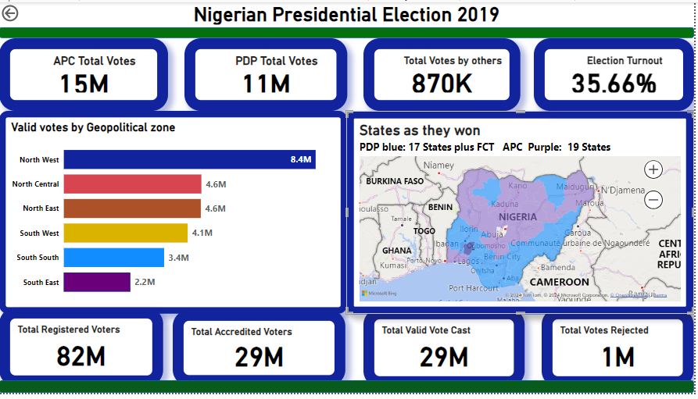
Election Summary on Dashboard

Slide 5
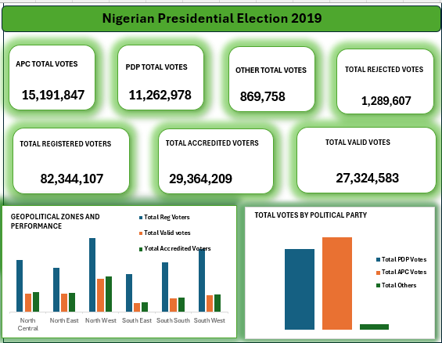
Election Summary on Dashboard

Slide 6
Voter Participation
Voter Turnout: 35.66%
Registered Voters: 82 million
Accredited Voters: 29 million
Rejected Votes: 1 million

Slide 7
Geopolitical Zone Voting Breakdown
North - West: 8.4 million votes
North - Central: 4.6 million votes
North- East: 4.6 million votes
South - West: 4.1 million votes
South - South: 3.4 million votes
South - East: 2.2 million votes

Slide 8
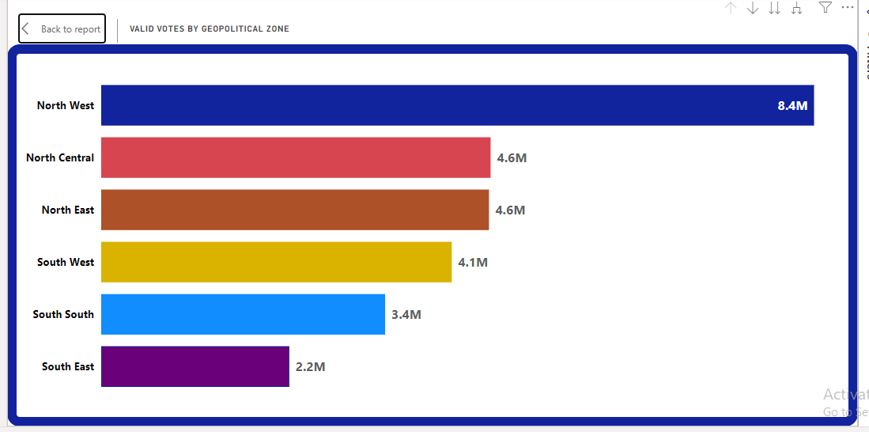
Geopolitical Zone Voting Breakdown

Slide 9
Regional Highlights
Highest Voter Turnout: North - West (8.4 million votes)
Lowest Voter Turnout: South - East (2.2 million votes)
Insights:
The northern regions contributed significantly to APC's lead.
South-South and South-East regions showed lower voting numbers.

Slide 10
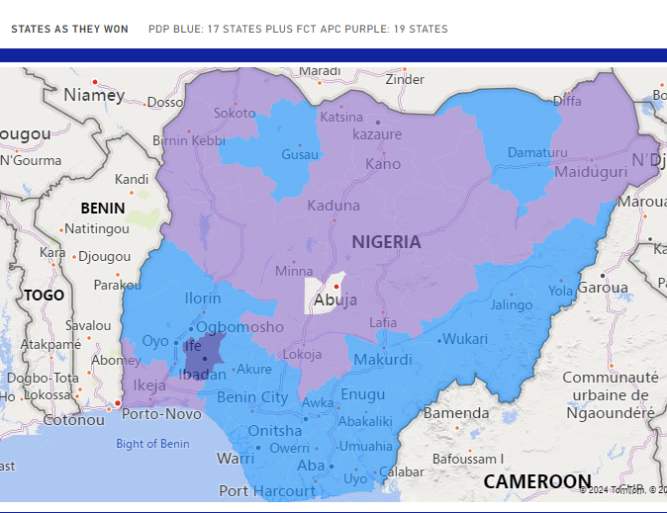
Election Turnout Map
APC won 19 States (highlighted in purple)
PDP won 17 States + FCT, Abuja (highlighted in blue)

Slide 11
Voter Distribution by Party
• APC: 15 million votes (57% of total votes)
• PDP: 11 million votes (42% of total votes)
• Others: 870,000 votes (1% of total votes)

Slide 12
Key Insights Summary
Winning Party: APC with a total of 15 million votes.
Second Leading Party: PDP with 11 million votes.
Overall Turnout: 35.66%
Geopolitical Influence: APC dominated in 19 states, while PDP won in 17 states + FCT.

Slide 13
Conclusion & Discussion
Election Trends:
The northern zones showed higher voting engagement.
APC had stronger support in states with higher voter turnout.
Questions & Discussion:
Open for discussion on election patterns and potential next steps for data use in public transparency.

Slide 14
Thank you.

